Slide 1
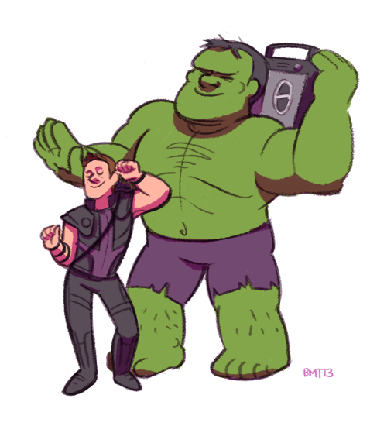
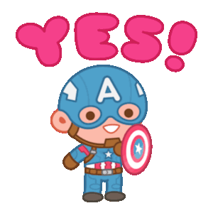
Did you finish your listening and writing homework?

Slide 2
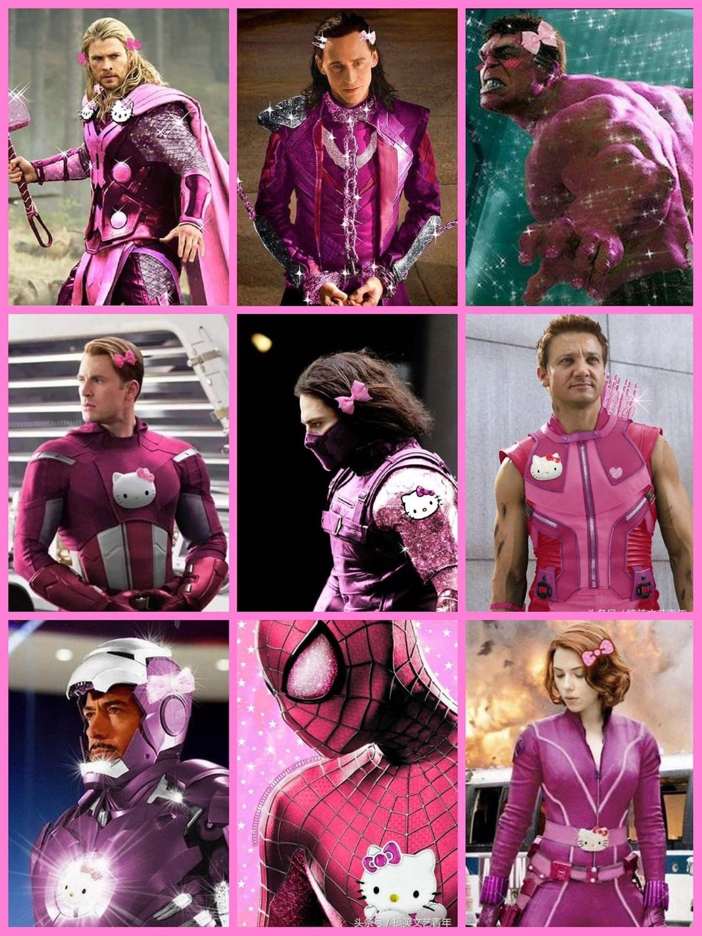
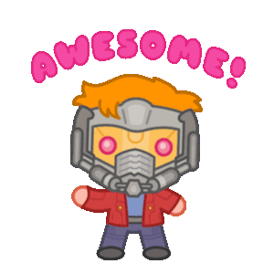
We are pink Avengers!

Slide 3
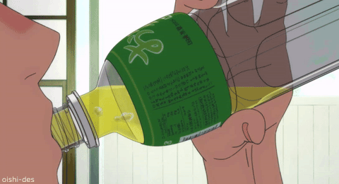
drinking
直接+ing

Slide 4
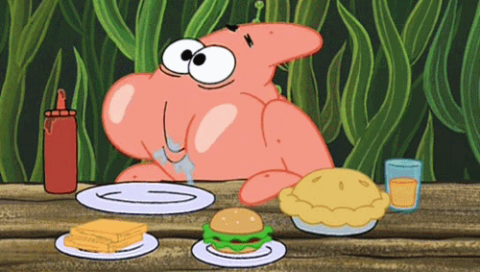
eating
直接+ing

Slide 5
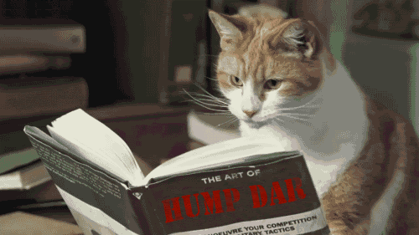
reading
直接+ing

Slide 6
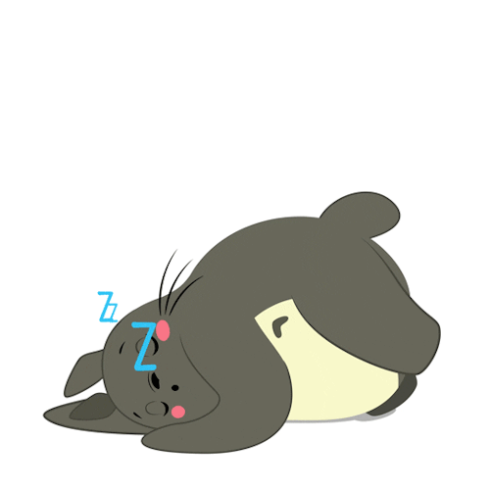
sleeping
直接+ing

Slide 7
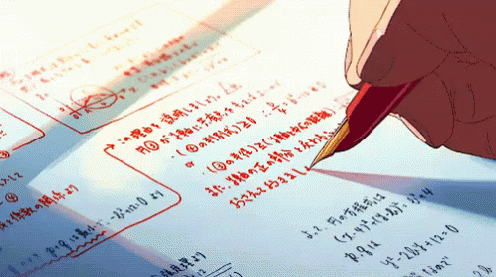
writing
字尾去e +ing

Slide 8
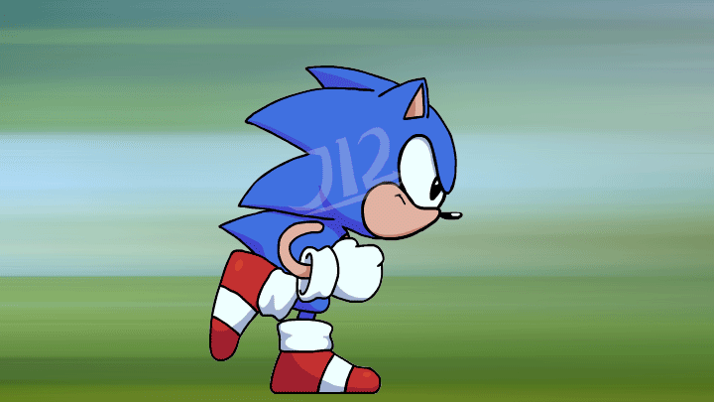
running
單字結尾是
子音+母音+子音，
重覆字尾 +ing

Slide 9
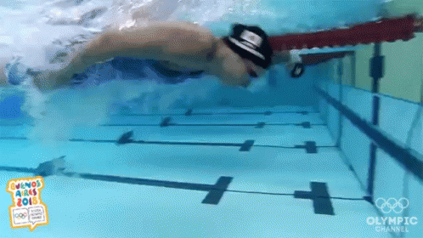
swimming
單字結尾是
子音+母音+子音，
重覆字尾 +ing

Slide 10
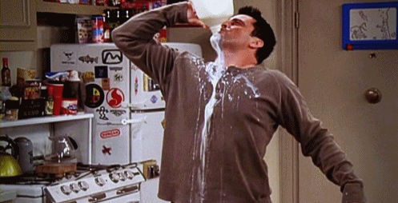
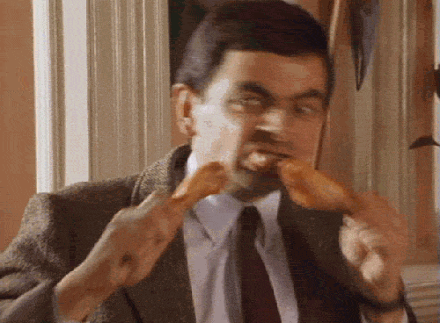
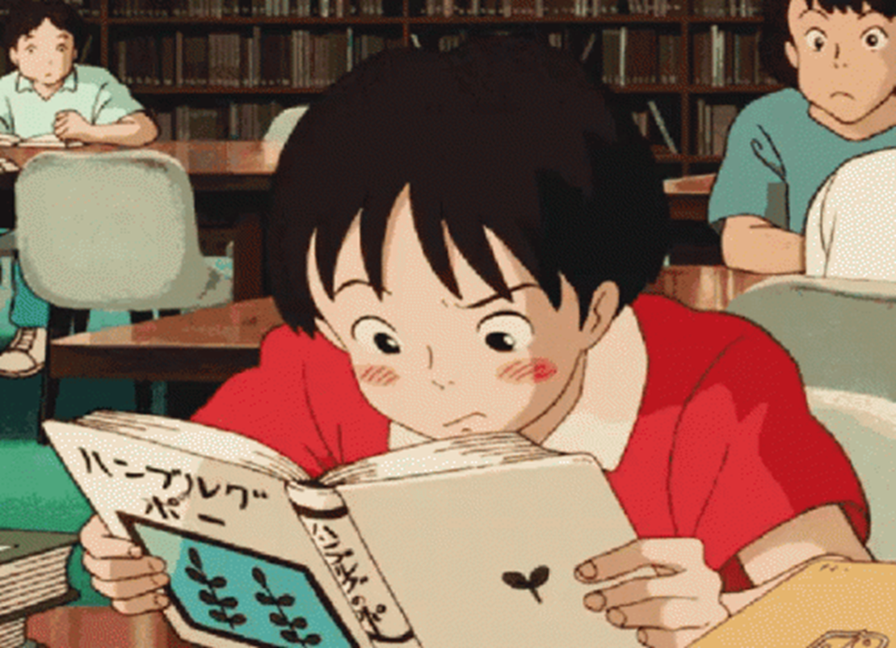
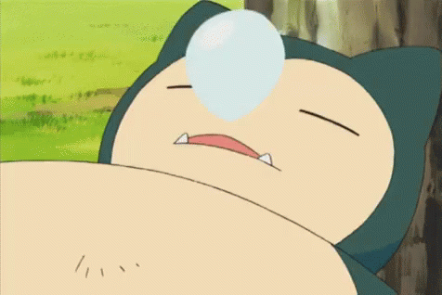
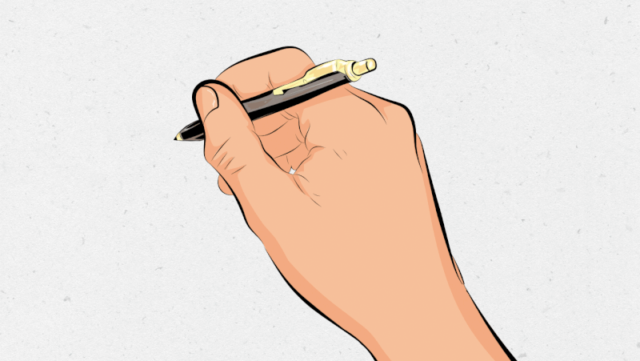
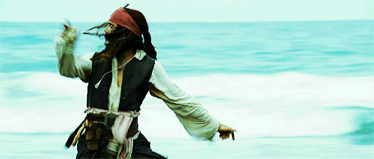
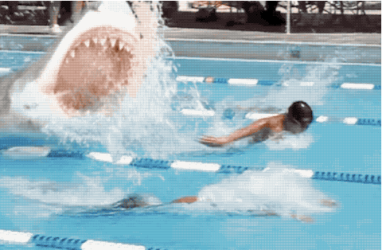
1
2
3
4
drinking
eating
reading
sleeping
5
6
running
7
swimming
writing

Slide 11
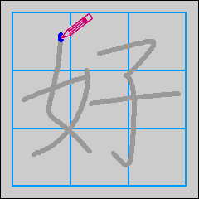
What are you doing?
I am writing.

Slide 12
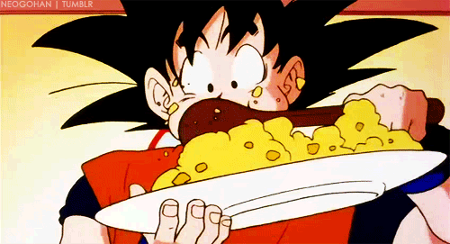
What is he doing?
He is eating.

Slide 13
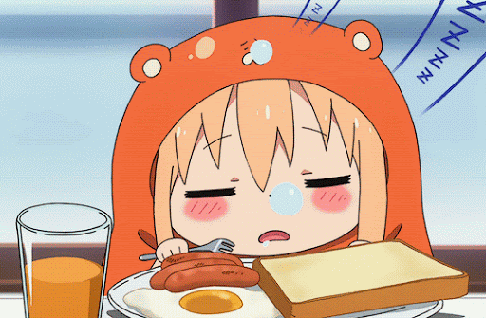
What is she doing?
She is sleeping.

Slide 14
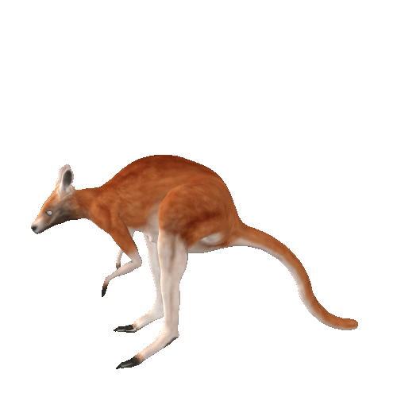
What is it doing?
It is jumping.

Slide 15
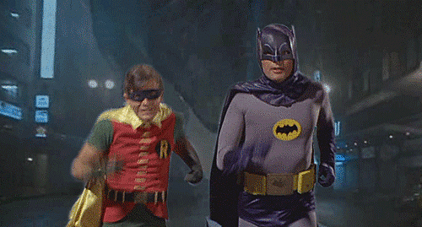
What are they doing?
They are running.

Slide 16
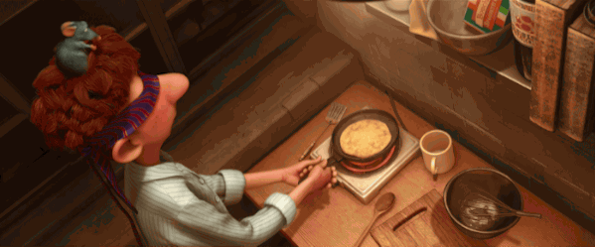
What are you doing?
We are cooking.

Slide 17
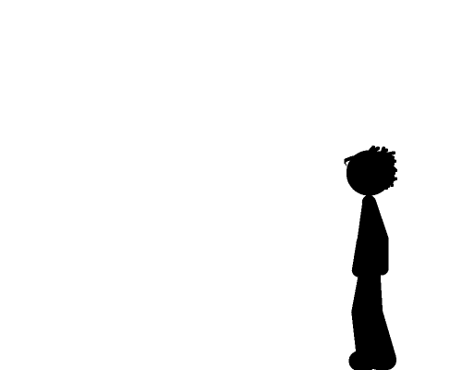
I am
walking and sitting.
What are you doing?

Slide 18
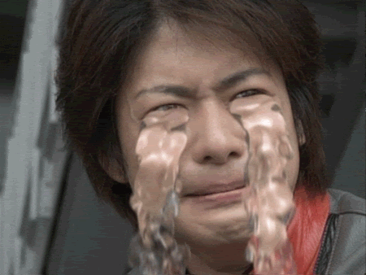
He is
crying.
What is he doing?

Slide 19
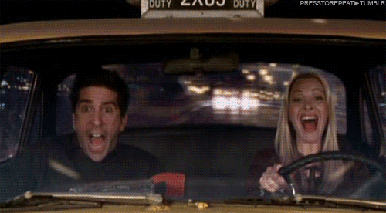
She is
driving.
What is she doing?

Slide 20
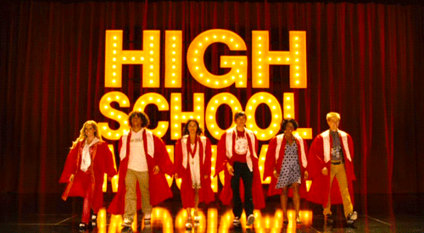
What are they doing?
jumping.
They are

Slide 21
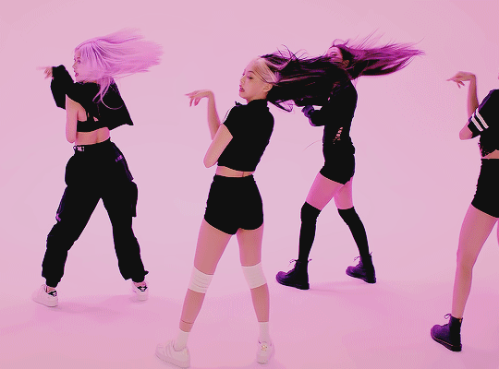
Blackpink is
dancing.
What is Blackpink doing?

Slide 22
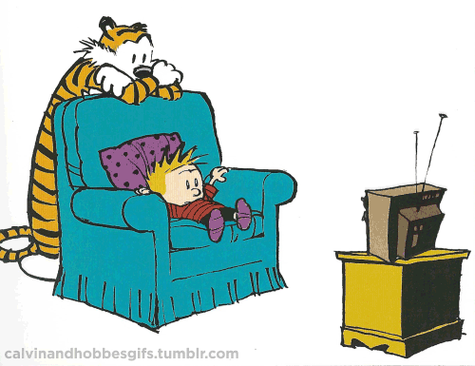
We are
watching TV.
What are you doing?

Slide 23
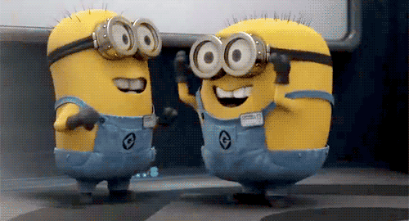
Let’s check the answers!!!
AEIBM/FOCKJ/NDHLG

Slide 24
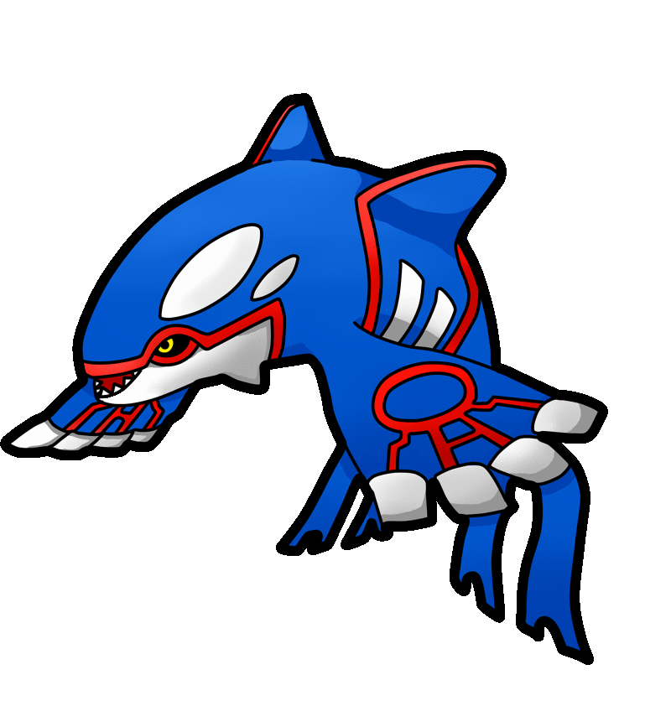
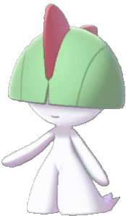
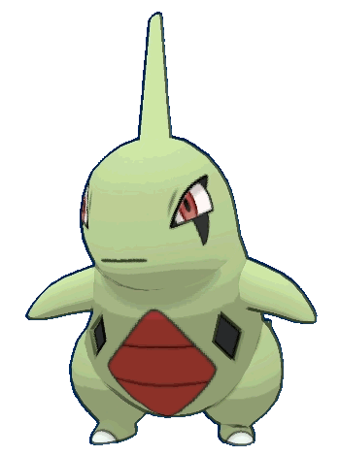
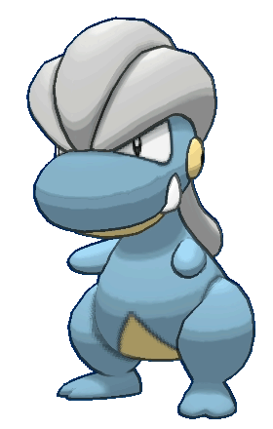
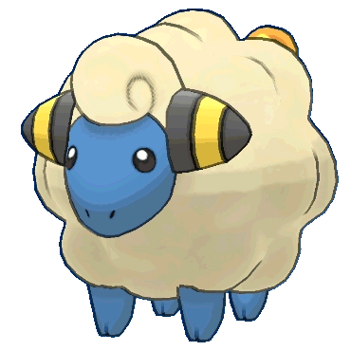
Homework this week
聽: CD1第52-56首。
說&讀:聽CD時跟著大聲唸。完成請
家長在課本P34簽名，下週換印章。
寫: ，下週一交。英語練習簿單字+縮寫轉換

Slide 25
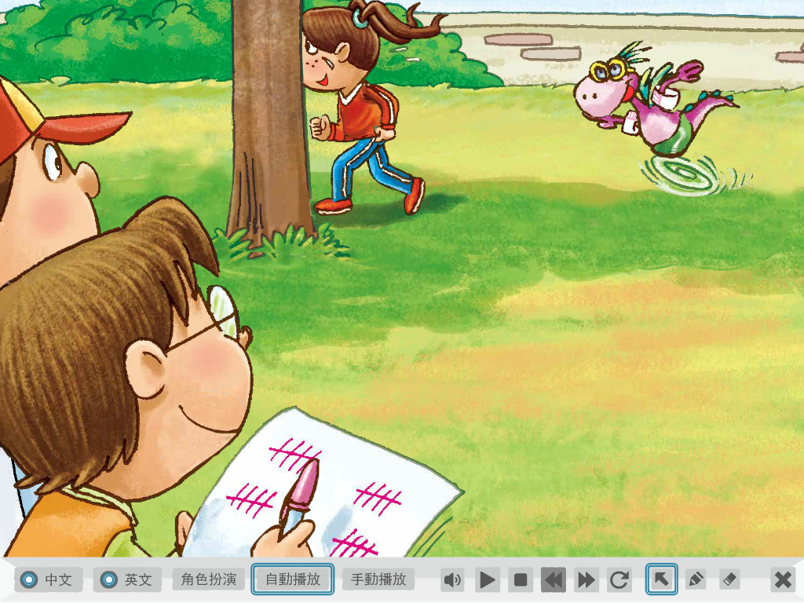
They are running.
They are counting.

Slide 26
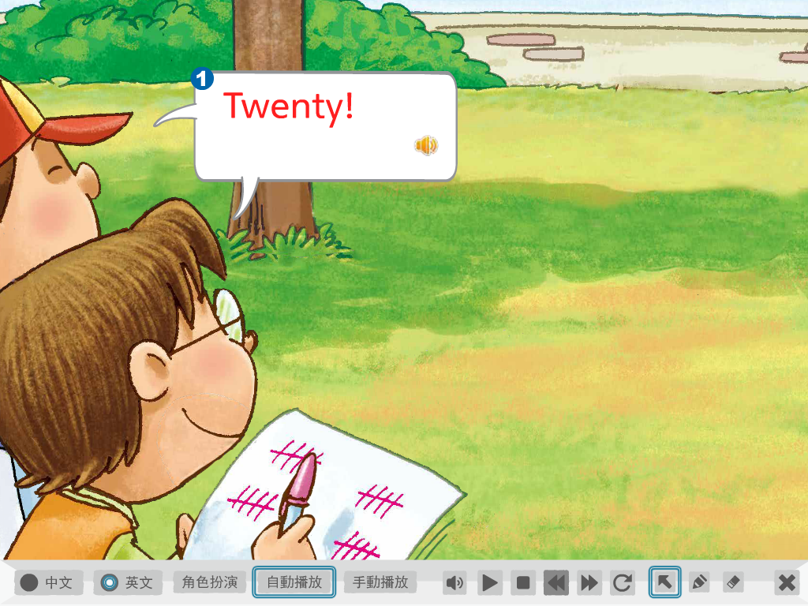

Slide 27
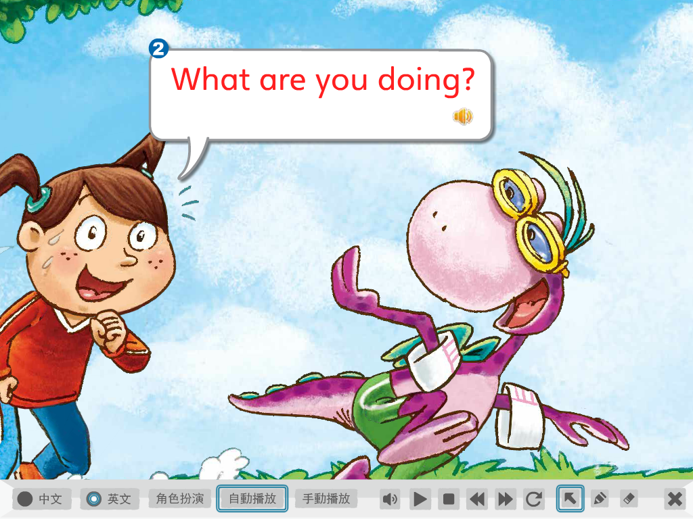

Slide 28
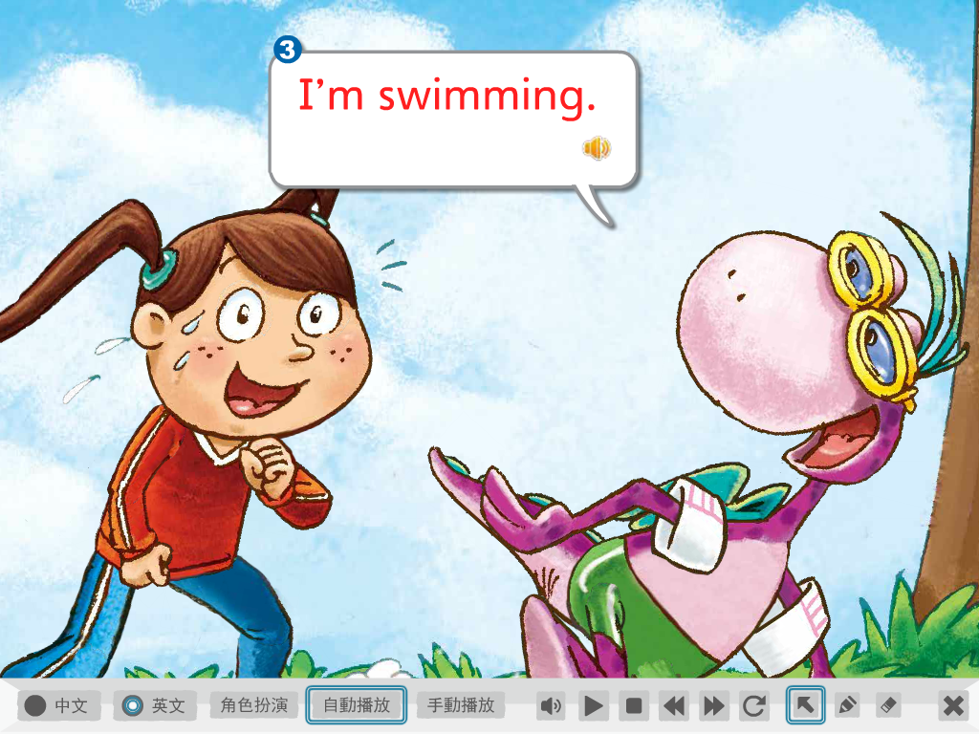
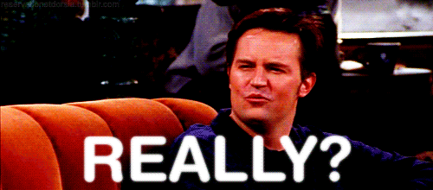

Slide 29
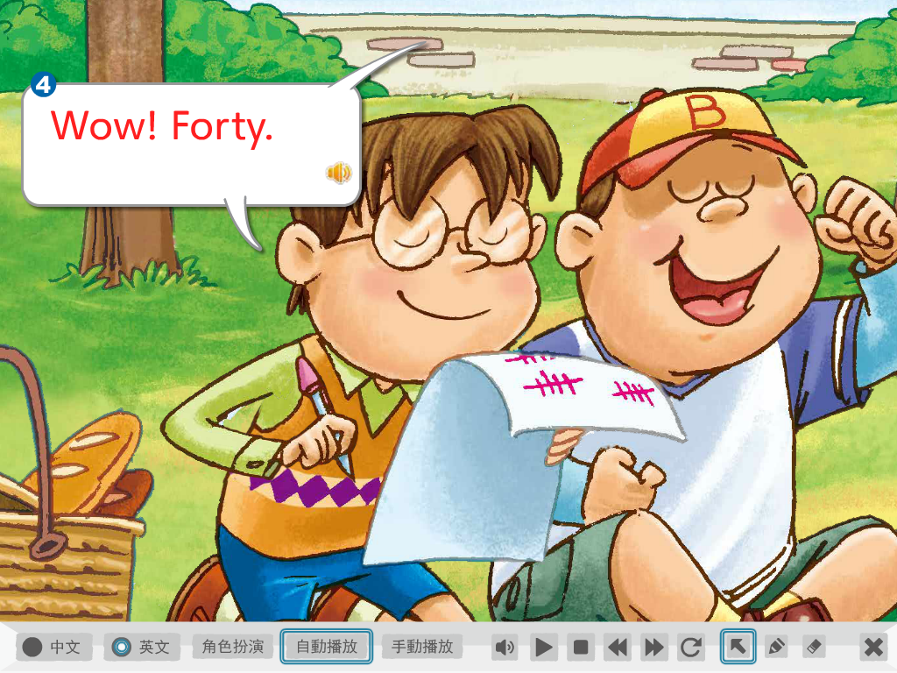
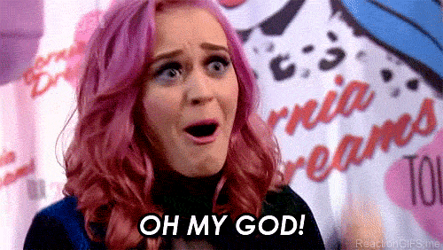

Slide 30
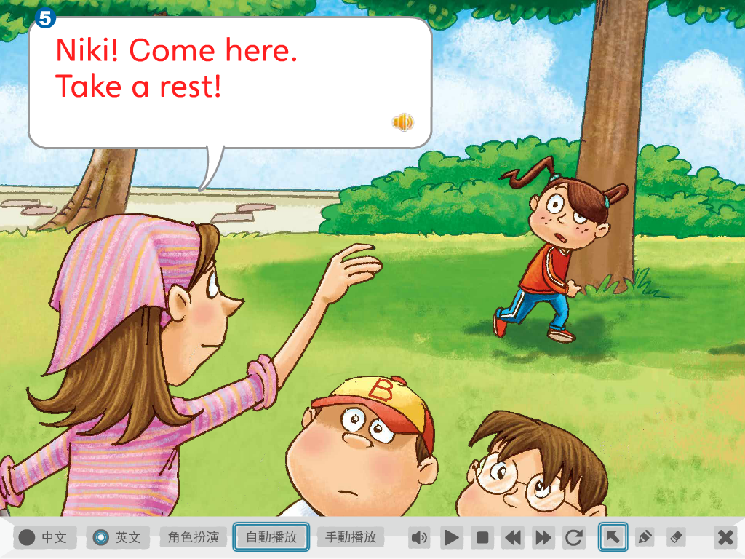
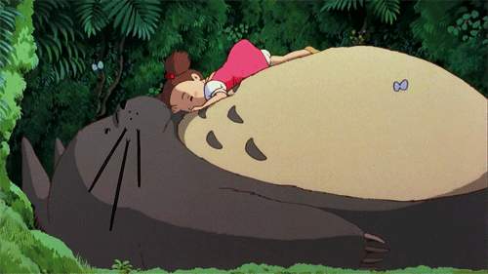
休息一下

Slide 31
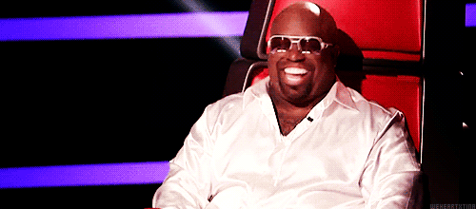
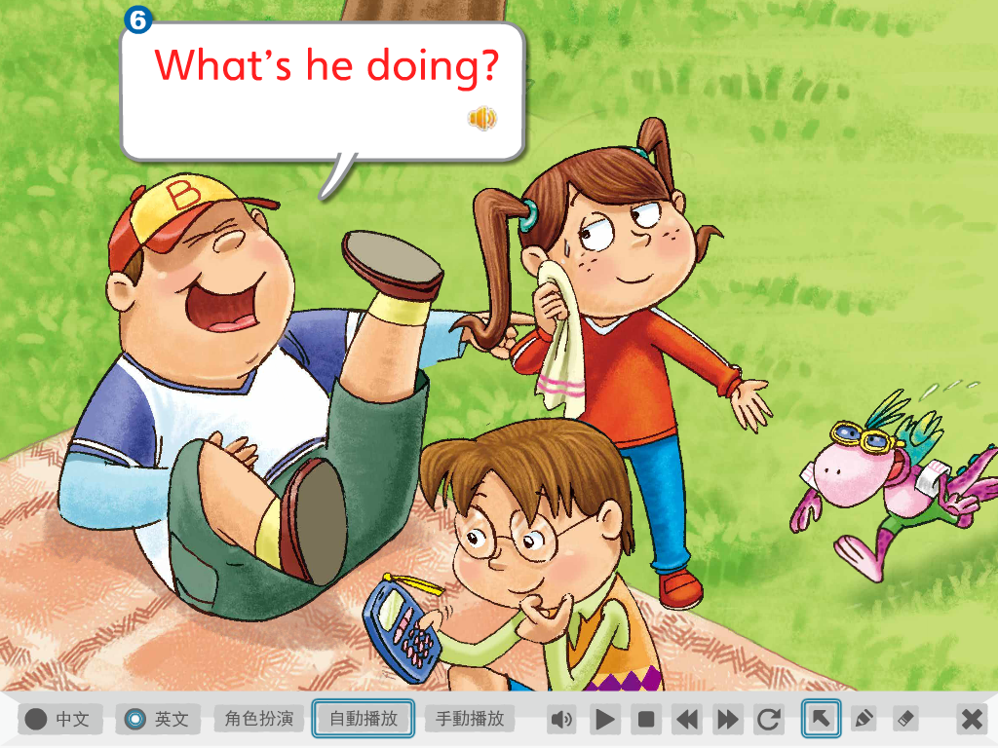

Slide 32
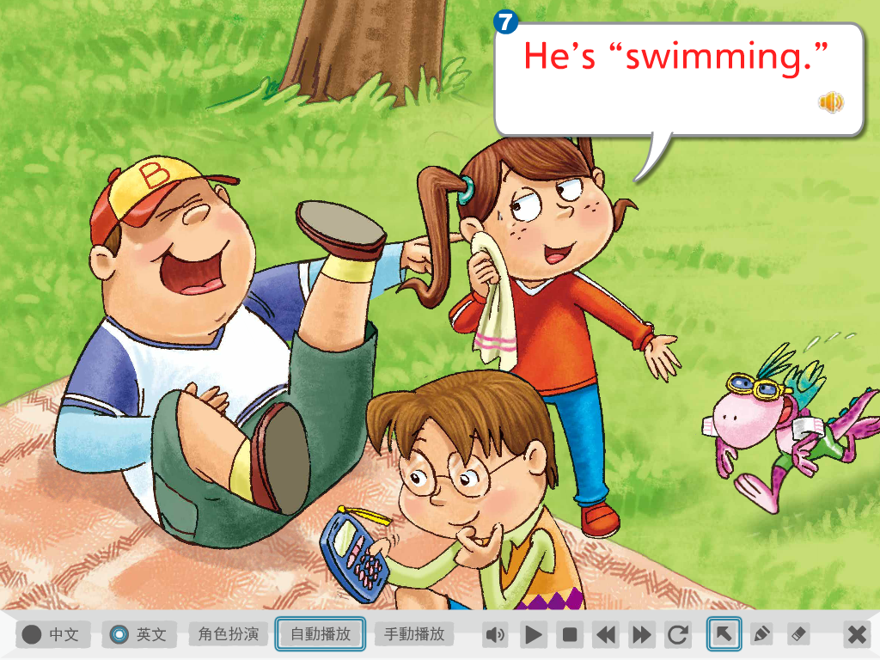

Slide 33
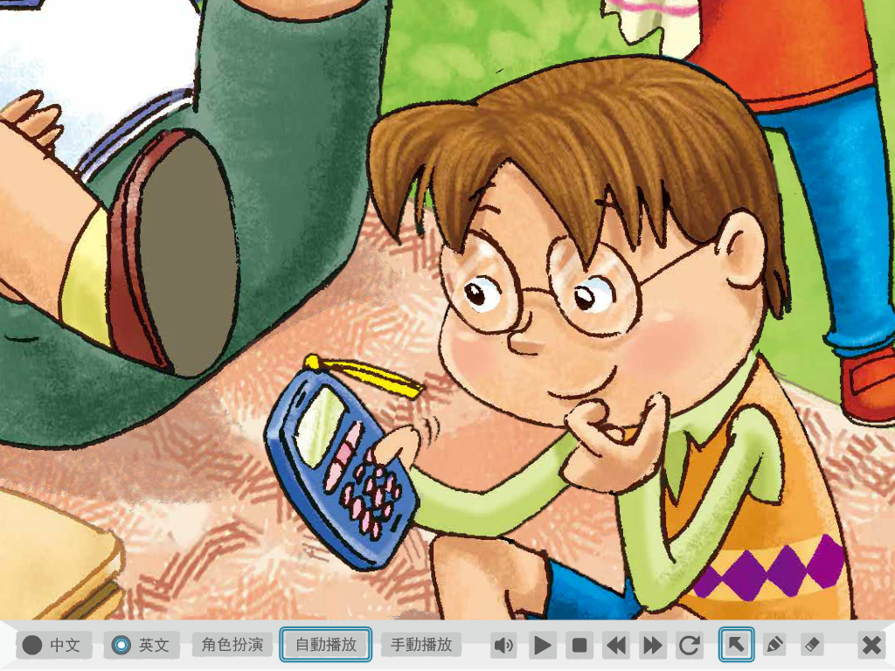
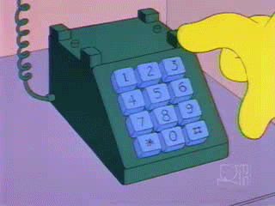
He is making a phone call.
He is dialing number.

Slide 34
太陽曬屁股囉!

Slide 35
怎麼了? What’s going on?

Slide 40
What’s Mr. Bean doing?
He’s crying.

Slide 41
No pain, no gain.

